Slide 1
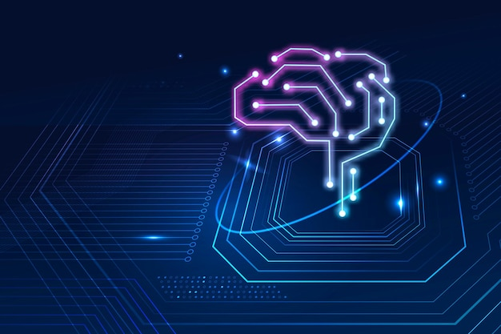
Machine Learning Algorithms (Support Vector Machine(SVM))
Md. Abu Naser Mojumder

Slide 2
Well known Machine Learning Algorithms
Supervised Learning
Unsupervised Learning
Reinforcement Learning
Regression
Simple Linear Regression
Multiple Linear Regression
Polynomial Regression
Clustering
K-Means Clustering
Hierarchical Clustering
Upper Confidence Bound(UCB)
Thomson Sampling
Classification
Logistic Regression
k-Nearest Neighbors(k-NN)
Support Vector Machine(SVM)
Naïve Bayes
Decision Tree Classification
Random Forest Classification
Dimensionality Reduction
Principal Component Analysis(PCA)
Linear Discriminant Analysis (LDA)
Deep Learning Algorithm
Artificial Neural Network(ANN)
Convolutional Neural Network(CNN)

Slide 3
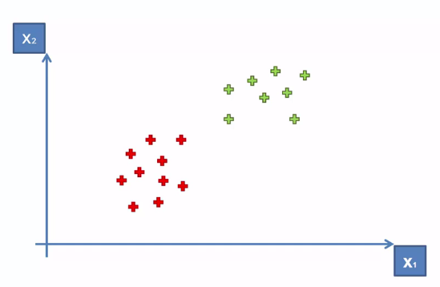
Support Vector Machine
“Support Vector Machine” (SVM) is a supervised machine learning algorithm that can be used for both classification or regression challenges.
Let we have two column(class) x1 and x2,
and some observations (red and green).
How can we separate them with a decision boundary line?
A decision boundary help us to make a decision for a new instance.

Slide 4
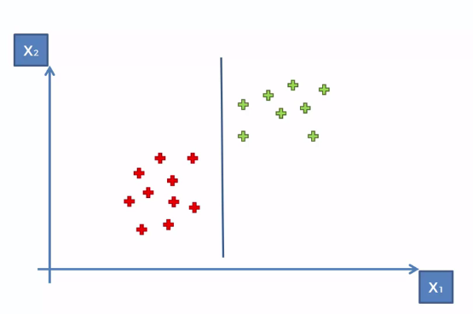
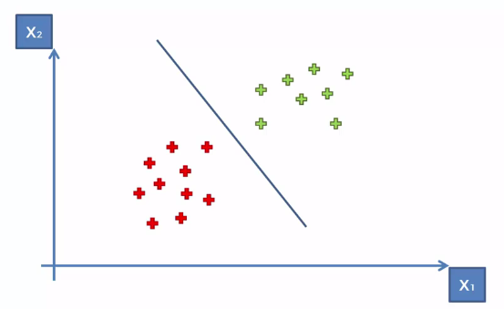
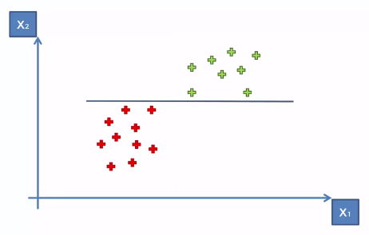
Support Vector Machine
We can draw any line to separate them….
Vertical Line
Diagonal Line
Horizontal Line

Slide 5
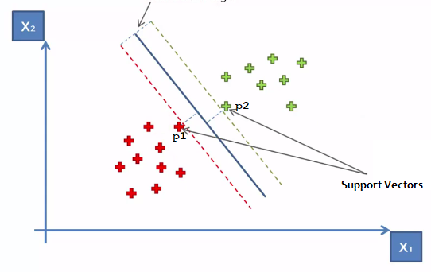
Support Vector Machine
How SVM search the decision boundary?
The line is searched through maximum margin.
The classification line is equidistance from p1 and p2.
Maximum Margin = Distance from p1 + Distance from p2
These two points are actually called the
“Support Vectors”.
These two points are supporting the whole algorithm, the other points don’t contribute to the algorithm, only these two points are contributing therefore they are called the Support Vectors.
Maximum Margin

Slide 6
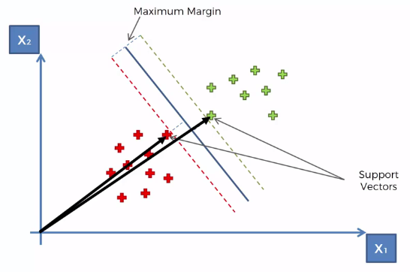
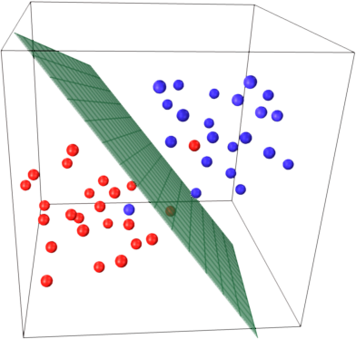
Support Vector Machine
Why they are called Vectors?
These points are nothing but position vectors!
These points can be Multidimensional.
Then we need position vectors for supporting the algorithm.
These position vectors help us to determine the decision boundary.

Slide 7

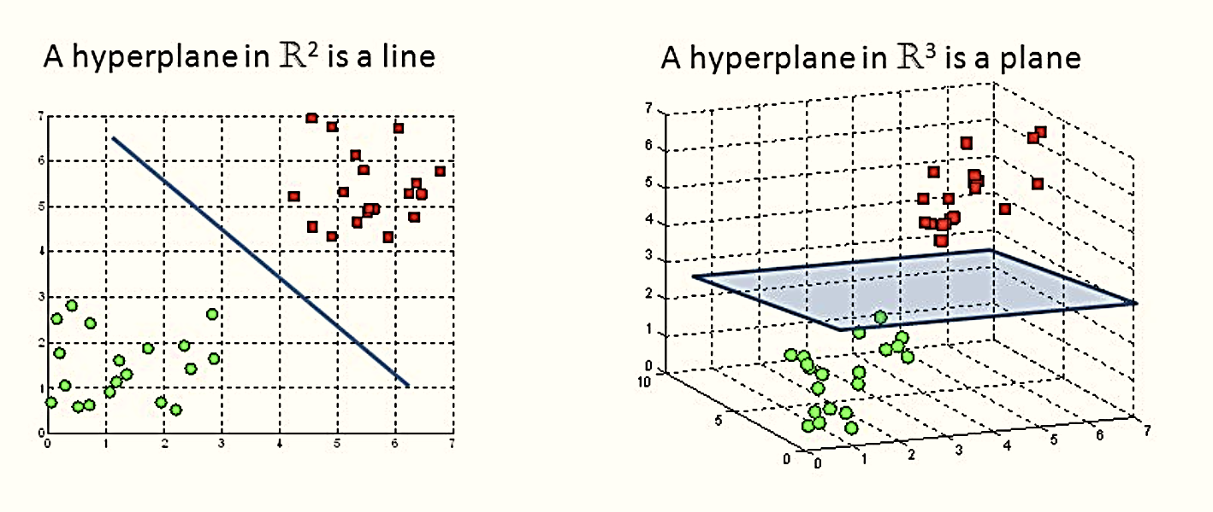
Support Vector Machine
Hyperplane
A hyperplane is a linear decision surface that splits the space into two parts.
The dimensions of the hyperplane depend on the features present in the dataset, which means if there are 2 features (as shown in image), then hyperplane will be a straight line. And if there are 3 features, then hyperplane will be a 2-dimension plane.

Slide 8
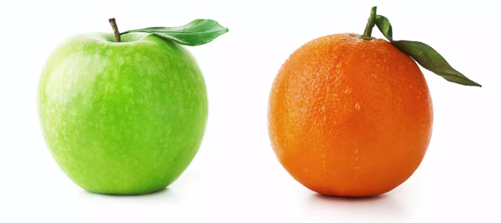
Support Vector Machine
What’s So Special About SVMs?
Let’s we want to train a machine to classify Apple and Orange.
When a new instance is given to the classifier it predict whether that is an Apple or Orange.

Slide 9
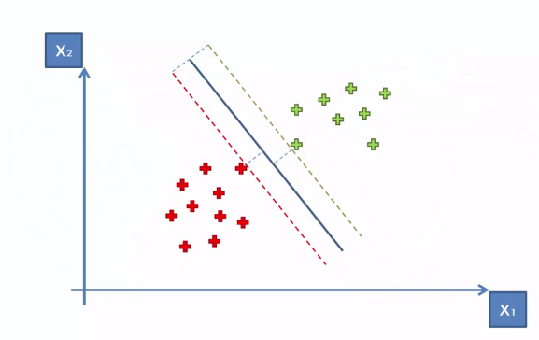
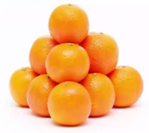
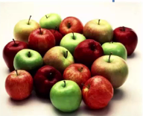
Support Vector Machine
What’s So Special About SVMs?
Heart on Orange Class
Very far from Apple Class
Heart on Apple Class
Very far from Orange Class

Slide 10
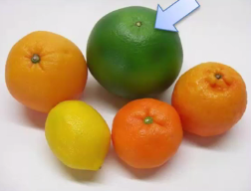
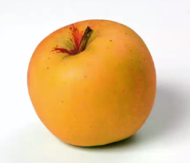
Support Vector Machine
What’s So Special About SVMs?
Support Vector
SVM looks for the extreme points(vectors) those are very close to the classification boundary.
Find most bad case for a class (most close Apple to an Orange or most close Orange to an Apple).
It can classify better than other classifier, and it is special!

